Slide 1
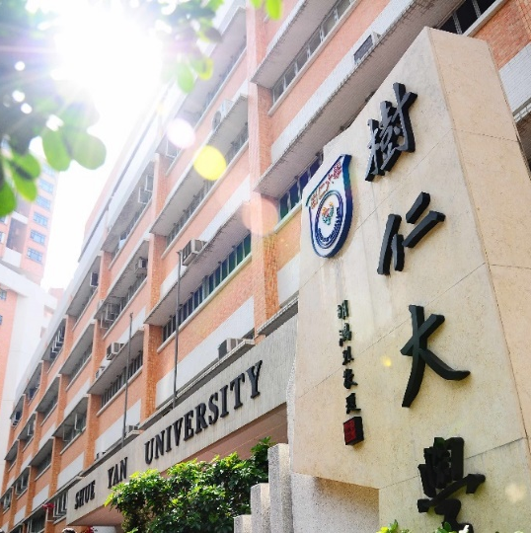
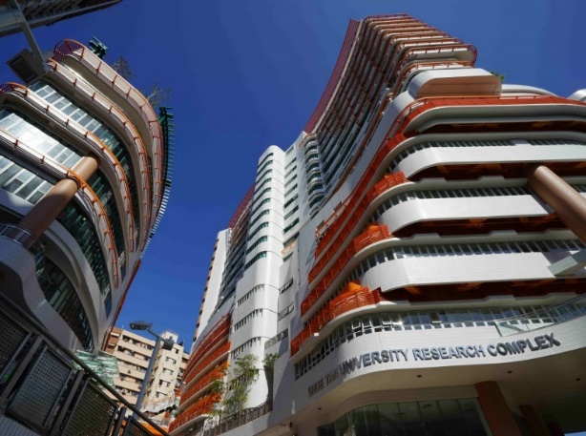
2022-23 年度
一年級同學修科指引
(四年共修125學分畢業)

Slide 2
First Year |  |  | Credits
Compulsory Courses
Language Requirements: |  |  | 14
CHI. | 101-2 | First Year Chinese (including Practical Chinese Writing)
ENG. | 111-2 | English Usage
Departmental Core Requirements: |  |  | 12
SOC. | 100 | Introduction to Sociology
SOC. | 103 | Introduction to Anthropology
SOC. | 108 | Introduction to Statistics
SOC. | 208 | Hong Kong Society and Culture
Departmental Elective Courses* (Choose 3 credits) |  |  | 3
SOC. | 204 | Cultures in the Contemporary World
SOC | 206 | Social Stratification
SOC. | 231 | Social Problem
SOC. | 257 | Art and Society
SOC. | 259 | Race and Ethnicity
SOC. | 260 | Food and Society
General Education Courses |  |  | 6
Total Credits |  |  | 35
*The Departmental Elective Courses offered might be subjected to change

Slide 3
Second Year |  |  | Credits
Compulsory Courses
Language Requirements: |  |  | 6
ENG. | 211-2 | English Writing
Departmental Core Requirements: |  |  | 12
SOC. | 205 | Sociological Theory I
SOC. | 207 | Sociological Theory II
SOC. | 221 | Social Research Methods
SOC. OR SOC. | 221A 221B | Applied Quantitative Social Research Methods Applied Qualitative Social Research Methods
Departmental Elective Courses* (Choose 6 credits) |  |  | 6
SOC. | 204 | Cultures in the Contemporary World
SOC | 206 | Social Stratification
SOC. | 231 | Social Problems
SOC. | 257 | Art and Society
SOC. | 259 | Race and Ethnicity
SOC. | 260 | Food and Society
General Education Courses |  |  | 6
Free Elective (Elective courses offered by other departments) |  |  | 6
Total Credits |  |  | 36
*The Departmental Elective Courses offered might be subjected to change.

Slide 4
Third Year |  |  | Credits
Compulsory Courses
Departmental Core Requirements: |  |  | 6
SOC. | 307 | Entrepreneurship and Society
SOC. | 308 | Culture, Heritage and Society
Concentration Departmental Elective Courses (Choose 6 credits according to your chosen concentration) |  |  | 6
Culture, Heritage and Innovation Concentration
SOC. | 311 | Sustainable and Innovative Cities in the Contemporary World
SOC. | 312 | Popular Culture in Asia
SOC. | 362 | Tourism and Culture
SOC. | 371 | Chinese Culture and Society
Entrepreneurship and Community Concentration
SOC. | 309 | Community Economy
SOC. | 310 | Social Enterprise in Asia
SOC. | 358 | Poverty, Social Policy and Social Innovation
Non-concentration Departmental Elective Courses* (Choose 12 credits) |  |  | 12
SOC. | 302 | Environmental Sociology
SOC. | 313 | Sociology of Education
SOC. | 321 | Economic Sociology
SOC. | 333 | Urban Sociology
SOC. | 334 | Sociology of Deviance
SOC. | 336 | Love, Family and Kinship
SOC. | 337 | Criminology
SOC. | 339 | Sociology of Religion
SOC. | 341 | Sociology of Development
SOC. | 356 | Gender Relation
SOC. | 357 | Migration and Mobility
SOC. | 359 | Self, Emotion and Culture
SOC. | 360 | Social Change and Modernity
SOC. | 380 | Arts and Everyday Life in the Digital Era
SOC. | 470 | Service Learning
Free Elective (Elective courses offered by other departments) |  |  | 6
Total Credits |  |  | 30
*The Departmental Elective Courses offered might be subjected to change.

Slide 5
 |  |  | Credits
Compulsory Courses
Departmental Core Requirements: |  |  | 3/6
SOC. OR SOC. | 400 401-2 | Senior Seminar Honours Project (for students whose GPAs are 3.0 or above)
Concentration Departmental Elective Courses (Choose 6 credits according to your chosen concentration) |  |  | 6
Culture, Heritage and Innovation
SOC. | 409 | Collective Memory and Social Change
SOC. | 413 | Digitized Media, Culture and Society
SOC. | 414 | Heritage Studies: Critical and Innovative Dimensions
SOC. | 415 | Film, Television and Society
Entrepreneurship and Community
BUS. | 480 | Business Ethics and Corporate Social Responsibility
SOC. | 411 | Impact of Social and Enterprise Innovation
SOC. | 412 | Contemporary Consumer and the Changing Community
Non-concentration Departmental Elective Courses (Choose 12 credits for Senior Seminar mode; Choose 9 credits for Honours Project mode) |  |  | 12/9
SOC. | 380 | Arts and Everyday Life in the Digital Era
SOC. | 359 | Self, Emotion and Culture
SOC. | 403 | Globalization and Inequality
SOC. | 406 | Selected Topics
SOC. | 410 | Sociology of Organizations
SOC. | 420 | Evaluation Research
SOC. | 430 | Economic Reform and Social Transformation in Contemporary China
SOC. | 440 | Collective Behaviour and Social Movements
SOC. | 490 | Work Placement
Total Credits |  |  | 21
*The Departmental Elective Courses offered will be subject to change.

